Slide 1

TarkariGhar
Team Interstellar:
Sagar Joshi
Rohan Dhakal
Pranaya Pradhan Sainju
Bibek Bhandari

Slide 2


TarkariGhar
फोन को भरमा तरकारी घर मा
At TarkariGhar, we bring the freshest and highest quality vegetables straight to your doorstep, ensuring your healthy eating goals are met with ease.

Slide 3
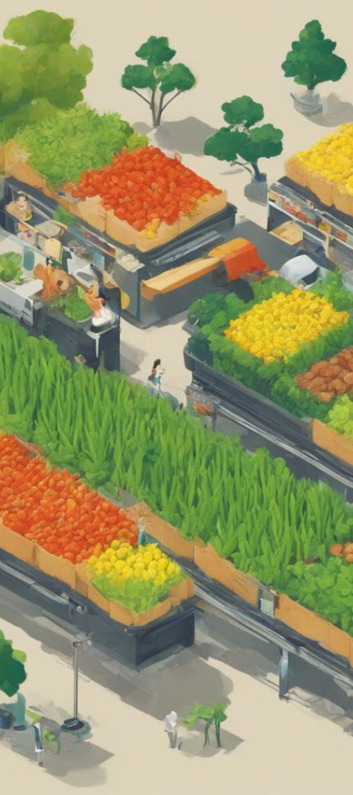
Statement of Problem:
Urban Lifestyle Challenges
In the fast-paced urban lifestyle, finding fresh vegetables can be a time-consuming and challenging task for many.
Rural Accessibility Issues
People living in remote areas often face limited availability and high prices for fresh and locally grown vegetables.
Quality Control
Traditional middleman and supply chains may compromise the freshness and quality of vegetables.

Slide 4

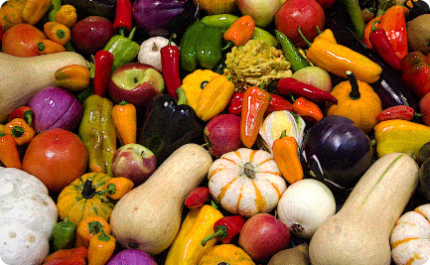
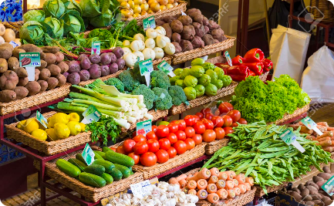
Evidence: The Importance of Fresh Vegetables
Health Benefits
Nutritional Value
Taste and Flavor
Research shows that a diet rich in fresh vegetables can lower the risk of chronic diseases and promote overall well-being.
Each colorful vegetable is packed with essential vitamins, minerals, and antioxidants, offering a wide array of nutritional benefits.
Freshly harvested vegetables have superior taste and flavor, enhancing the culinary experience in various dishes.

Slide 5
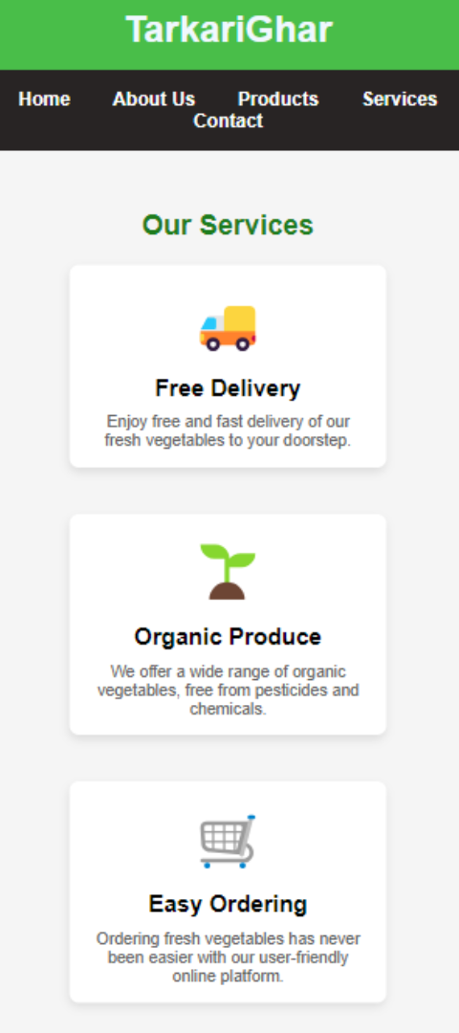
Our Solution: Convenient and Fresh
1
Direct Sourcing
We eliminate middlemen by directly sourcing vegetables from local farmers, ensuring freshness and quality.
2
Online Ordering
Our user-friendly online platform allows customers to conveniently browse our wide selection and place orders at their convenience.
3
Doorstep Delivery
We deliver fresh vegetables right to our customers' doorsteps, saving time and effort in their busy lives.

Slide 6

User
Website
How it Works: General Flowchart
Products
Order
From order placement to delivery, our streamlined process ensures a seamless experience for our valued customers.
Delivery

Slide 7
Software Development Methodology
We follow an Agile development approach to ensure continuous improvements and meet evolving customer needs.
Regular sprints, iterative development, and constant feedback help us deliver a robust and user-friendly online store.

Slide 8

Future Works for Our Project
1
Expansion
We plan to expand our reach to more cities and regions, making fresh vegetables accessible to a wider population.
2
New Partnerships
We aim to build partnerships with local farmers and community organizations to support sustainable agriculture and promote local economies.
3
Enhanced Features
We will continue to enhance our online platform with new features and personalized recommendations to provide an improved shopping experience.

Slide 9
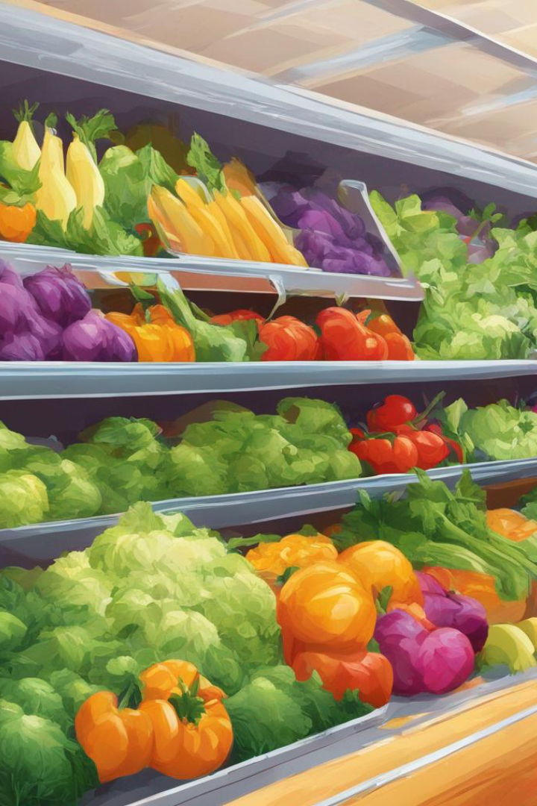
Conclusion
At TarkariGhar, we are committed to ensuring everyone has access to fresh, nutritious, and delicious vegetables. Join us in our journey towards healthier and happier lives!

Slide 10

References
World Health Organization - https://www.who.int Centers for Disease Control and Prevention - https://www.cdc.gov

